Slide 1
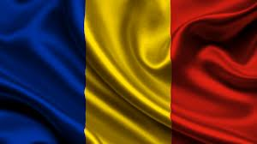
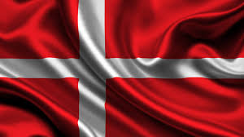
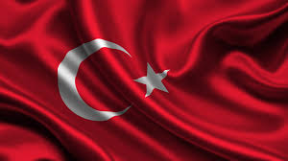
FOLLOWING IN
THE FOOTSTEPS OF OUR ANCESTORS - THE STORYTELLERS

Slide 2
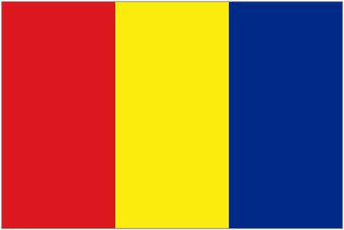
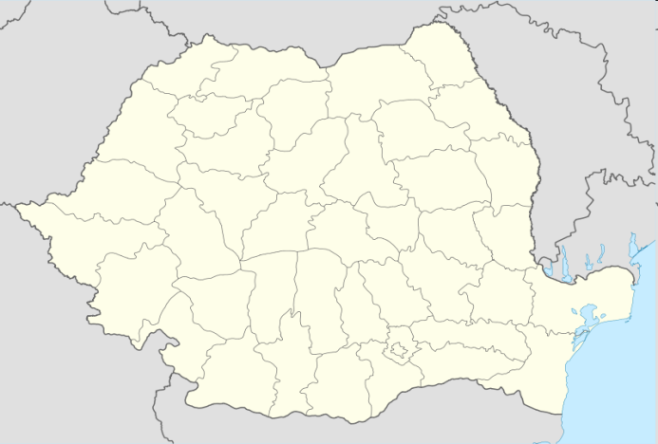
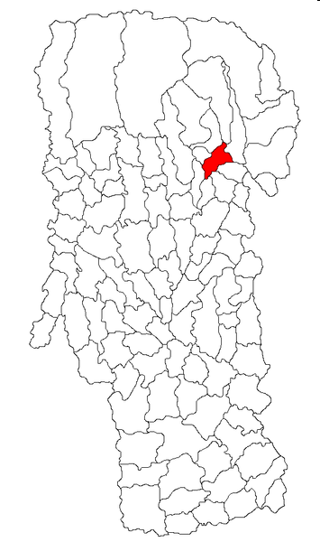
CÂMPULUNG MUSCEL
Amplasare: 45°16′N 25°3′E
Țară: România
Judeţ: Argeş;
Atestare documentară - secolul al XIII-lea
Populaţie: 38.209 locuitori

Slide 3
Geographic Location of Campulung Muscel
The North-Eastern part of Arges County is characterized by a particular relief: mountains, hills and plateaus.

Slide 4
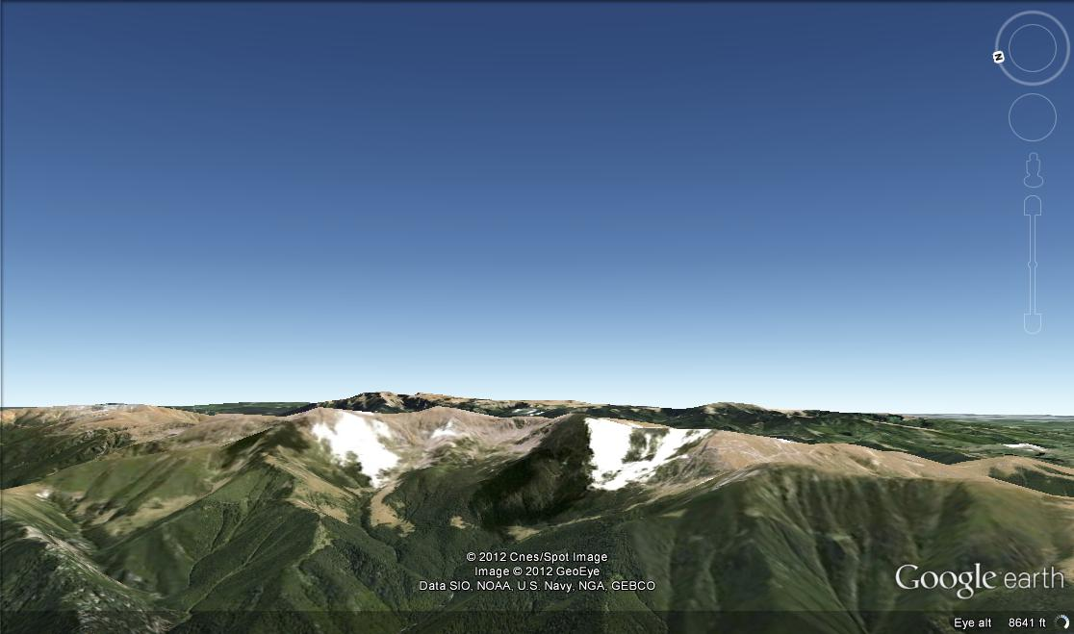
Campulung Muscel and the surrounding settlements are included within this frame.
The variety of the relief features and their type of fragmentation reside in a complex geological structure. The mountains, high and massive are crossed by deep valleys that separate long and ramified mountainous summits southwards oriented.

Slide 5
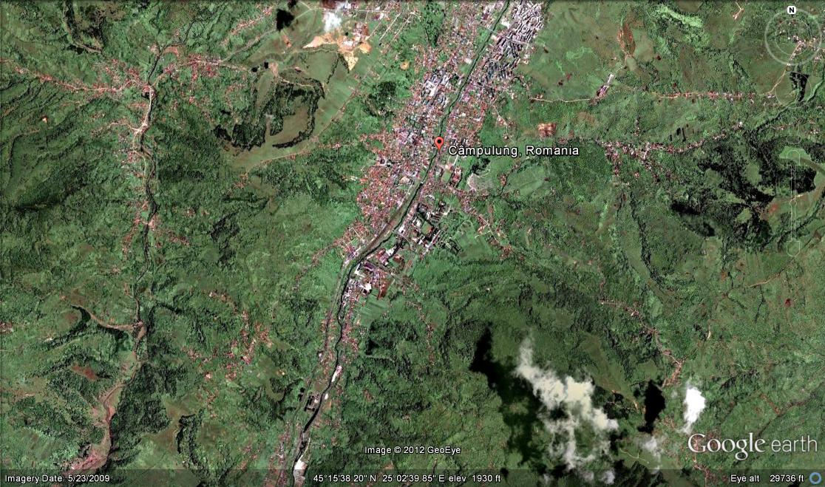
North of Campulung, between
rivers Doamnei and Dambovita, raises Iezer Mount, a distinct relief unit.
The depression of
Campulung is also
bordered by the Papusa,
Leaota and Piatra
Craiului mountains
and it is one of the
most defined
depressions in Romania.

Slide 6
To the South, it is limited by high sub-Carpathian hills (bearing the local name of “muscele”, from the Latin word “monticellae”), covered with pastures, hayfields and orchards of various fruit trees.
The passage from Campulung to Rucar-Bran and Brasov, between Piatra Craiului and Leaota Mountains has very much influenced the economic development of Campulung Muscel and its surroundings and has represented for ages an active bound between Vallachia and Transylvania.

Slide 7
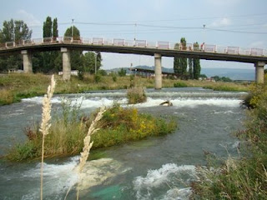
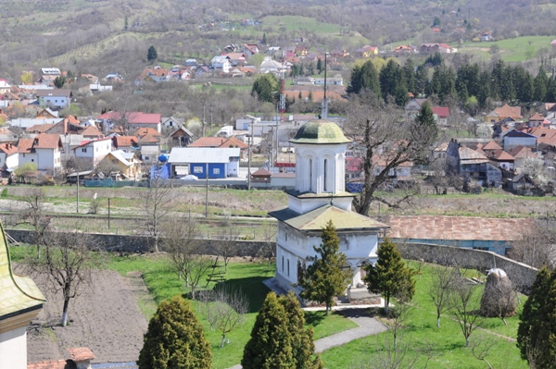
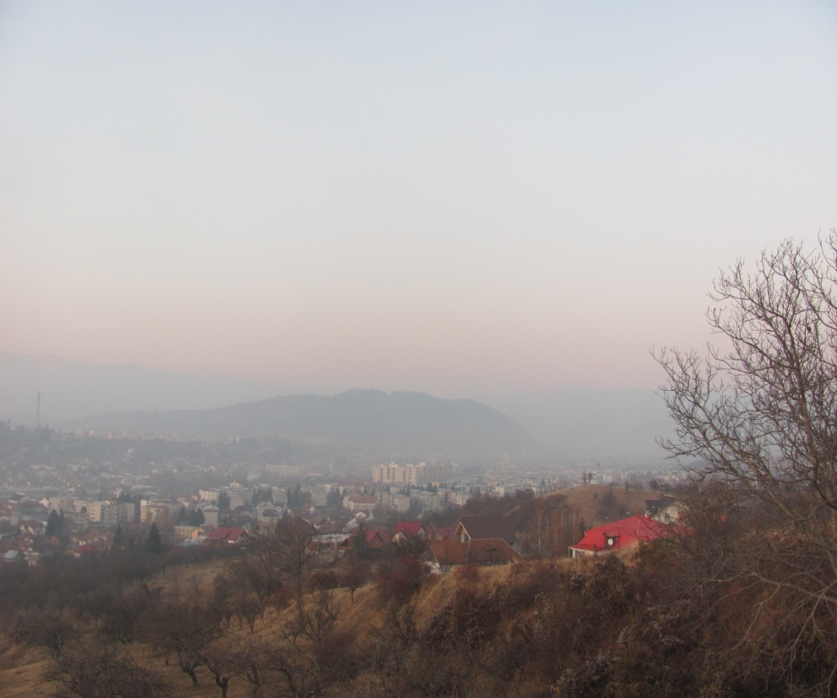
The town has developed along Raul Targului valley, but also on higher terraces around the depression.

Slide 8
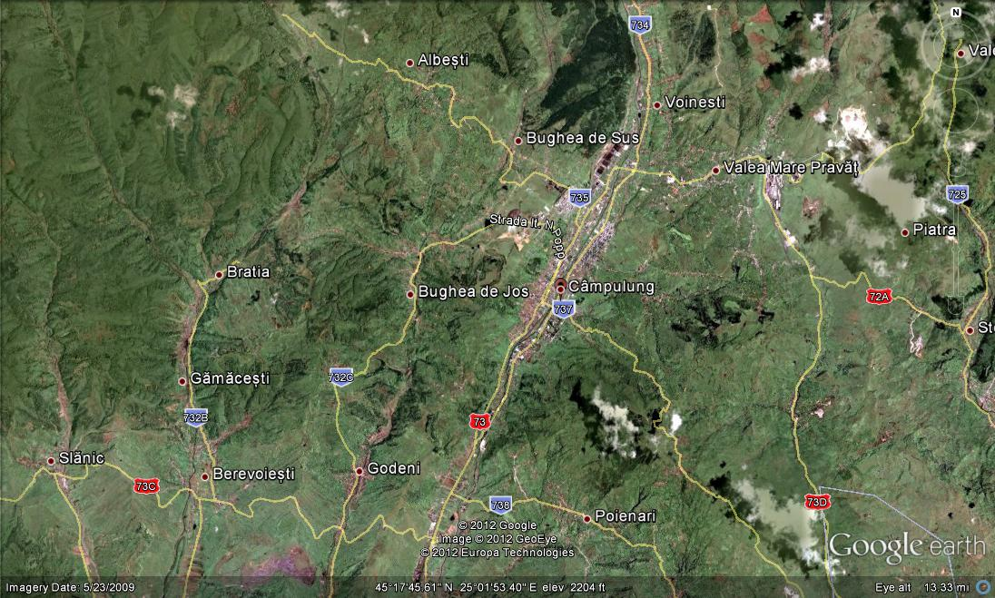
An entire road system connects to the town the closer or further villages. At present, driveways connect Câmpulung with Pitești and Brașov on DN 73.

Slide 9
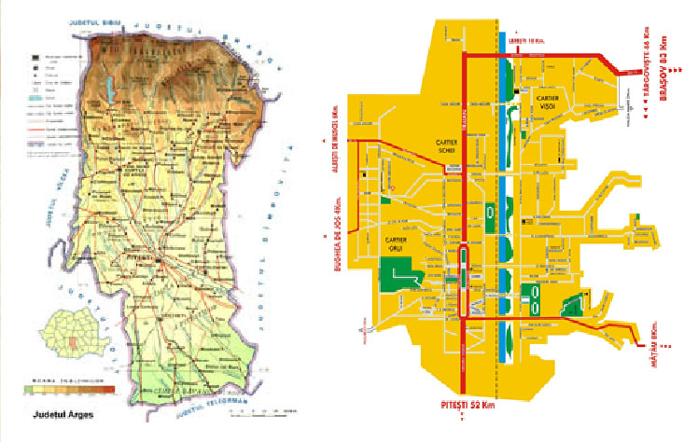

Slide 10
MULTILATERAL COMENIUS PROJECT 2013-2015
This project has been funded with support from the European Commission.
This publication reflects the views only of the author, and the Commission cannot be held responsible for any use which may be made of the information contained therein.

