Slide 1
FOLLOWING IN
THE FOOTSTEPS OF OUR ANCESTORS - THE STORYTELLERS

Slide 2
Royal Court and Monastery Ensemble "Negru-Vodă"
“Passing on the rough roads, through forests and over hills and valleys, with frequent ups and downs, I came in the evening to a place called Câmpulung, which is a big city, with a thought to visit the monastery there, dedicated to the Assumption.
The meaning of the name Câmpulung in Romanian is "long plain" and it really is the appearance of this place, for it is a very long city and a river flows through its middle. [....] The Church stands on four beautiful, grand pillars. The belfry is large and very high. City population, with priests and monks, greeted us outside the gates; and once I entered the church, the Vespers for the Sunday of the Pharisee and the tax collector began.”
Paul of Aleppo, The Travel of Patriarch Macarius of Aleppo (1652 - 1659)

Slide 3
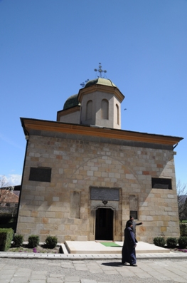
Câmpulung Monastery, now known as "Negru-Vodă", was rebuilt by Matei Basarab on the place of the residence of the first prince of Wallachia.
Old Princely Church, rebuilt twice on the old foundations (in the seventeenth century and the nineteenth century) was built by King Basarab I, who died in Câmpulung (1351-1352) and his son, Nicolae Alexandru Basarab.

Slide 4
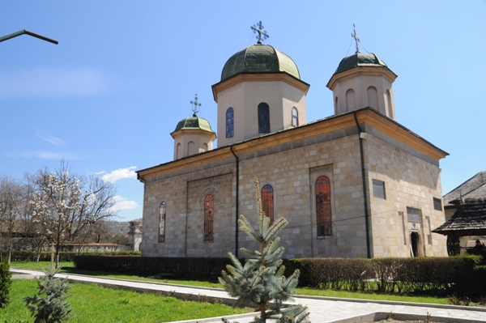
The original basilical plan had three naves and a narthex. A scale located in the upper narthex leads to a tower. Remarkable synthesis of western and other elements of the Byzantine tradition, of impressive size, the monument appears to be unique in Wallachia.
It stated the prestige and authority of the ruler, in a city where there were two important buildings of the Catholic cult.

Slide 5
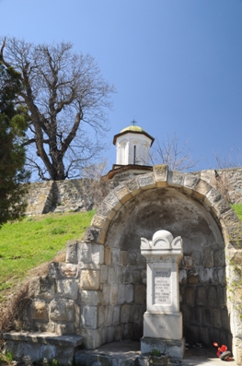
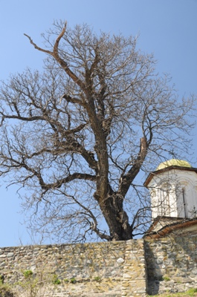
Destroyed by the earthquake of 1628, the church was completely rebuilt in 1635-1638, with reuse material from the old building, superimposed on its contours.
The new sanctuary had a tower resting on four pillars of wall and two smaller towers above the altar side compartments.
The interior stairs were leading to the bell.

Slide 6
The Princely ensemble around the church no longer keeps any of the buildings dating from the fourteenth century. The entire place was surrounded, 12 to 14 m away, by a wall of stone.
Throughout the south side there were discovered traces of a wave of land with stones, reinforced with wood in some areas, more than eight meters wide.
East of the church there were found the remains of a rectangular building, measuring about 10 m, with walls of stone retaining traces of interior plaster, paved inside with bricks.
It is assumed that this, together with others found further south, may have dated from the fourteenth century, part of the royal residence buildings.

Slide 7
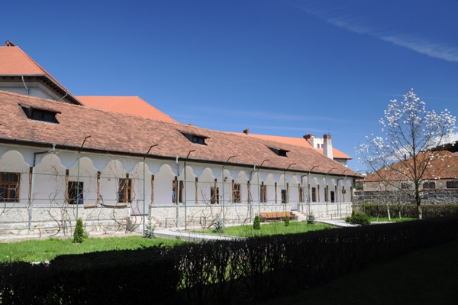
The princely court structure has been completely changed from 1635 until 1648, after the founding of the church.
One of the main buildings erected by Matei Basarab, probably in1635 - 1648, was the residence to the southwest of the church, called "the Priest’s House.”
It has a cellar covered with a semi-cylindrical vault. Above the basement and an L-shaped corridor stand four rooms, with two small vaulted corridors.

Slide 8
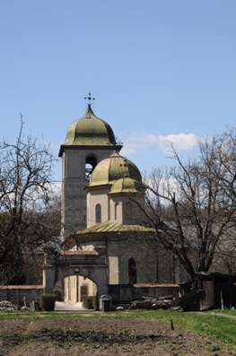
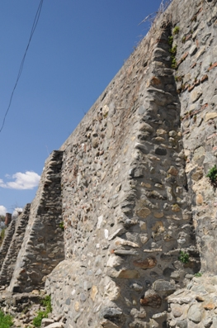
The assembly is dominated on the west side by the bell tower, 30 m high, with a square plan. The entering at the ground floor is covered with a cap with pendants.
Northwards, a staircase provides access to the first two floors, continued with wooden interior stairs to the open bell chamber.
The exterior is decorated with overlapping arches, belts and glazed ceramic. The decor is complemented by pieces made from the former Dominican Kloster (“Cloaşter”): a cornerstone of Gothic feature and a relief representing a deer.

Slide 9
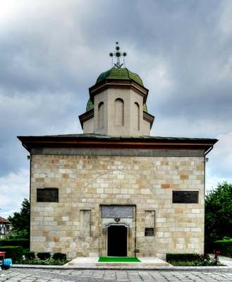
Perhaps the lower level of the building, north of the tower, dates back to the seventeenth century - "The Royal House" - and also a body of hermits’ rooms, joined to the north.

Slide 10
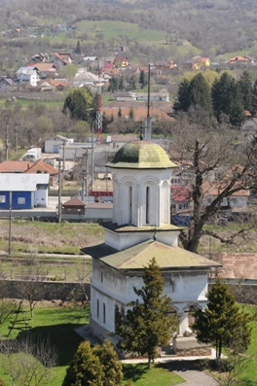
In the extreme south-east is the Infirmary Church, originally built of wood on a foundation of stone slabs.
It was rebuilt in 1718; is small in size, harmoniously proportioned, rectangular, with only the altar, nave crowned by a tower and an open porch, covered by a cap and surrounded by trilobite springs.
The porch retains few traces of ancient fresco painting, of a special quality.
The interior was repainted by George Tattarescu.

Slide 11
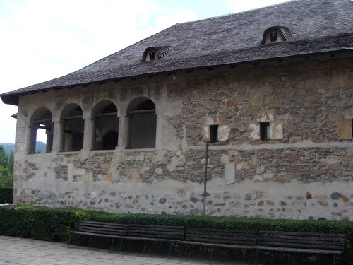
King Matei Basarab installed in Negru-Vodă Monastery a printing house where there were printed four books that have spread throughout the country: in 1635, "Slavonic Prayer Book”; in 1642, "Lessons for Every Day," 1642-1643, "Slavonic Anthology" and in 1650, "Slavonic Psalter".
For printing needs, the prince established a paper mill on the river.

Slide 12
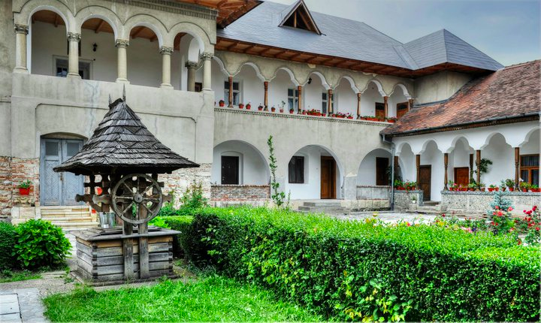
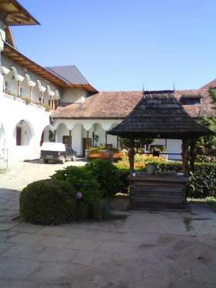
Also, Matei Basarab moved near the monastery the town fair of St. Elias (“Sborul”), raising an inn and shops, located to the northeast.
The monastic compound was transformed in the eighteenth century, when the body of buildings on the south side and the shops yard were set in.

Slide 13
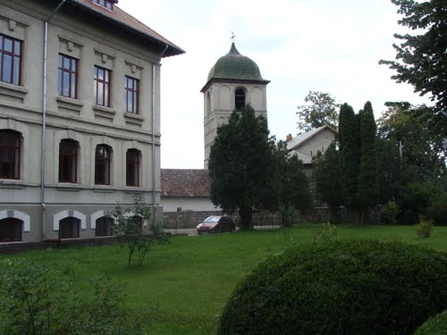
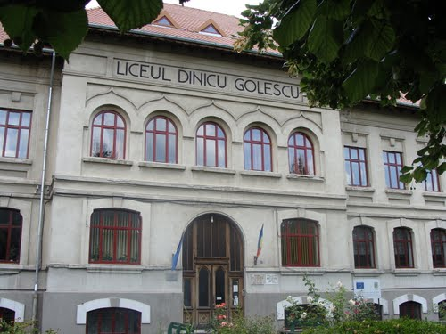
In the first half of the twentieth century, on the surface where the inn and shops stood, there was built "Dinicu Golescu" high school.
With the new construction, very important vestiges of the old royal residence, the inn and shops were damaged.

Slide 14
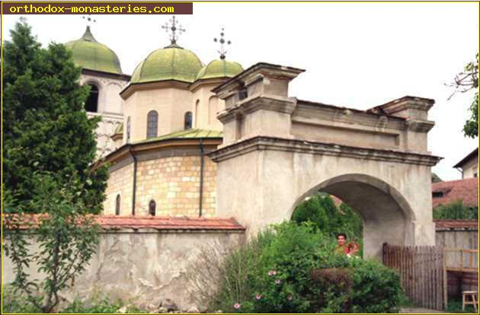

Slide 15
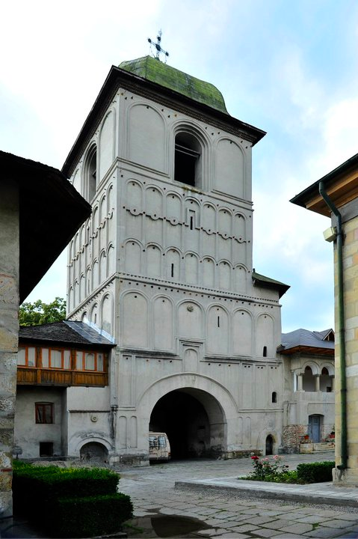
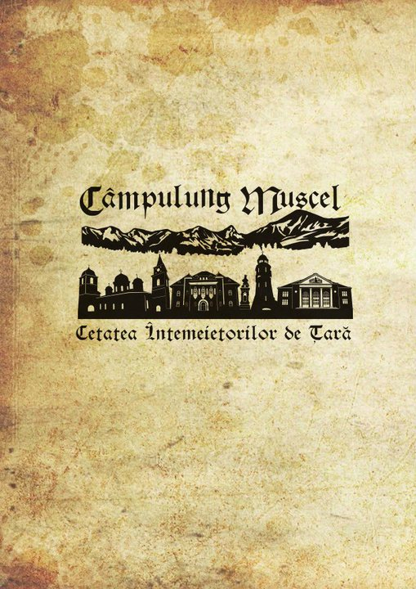
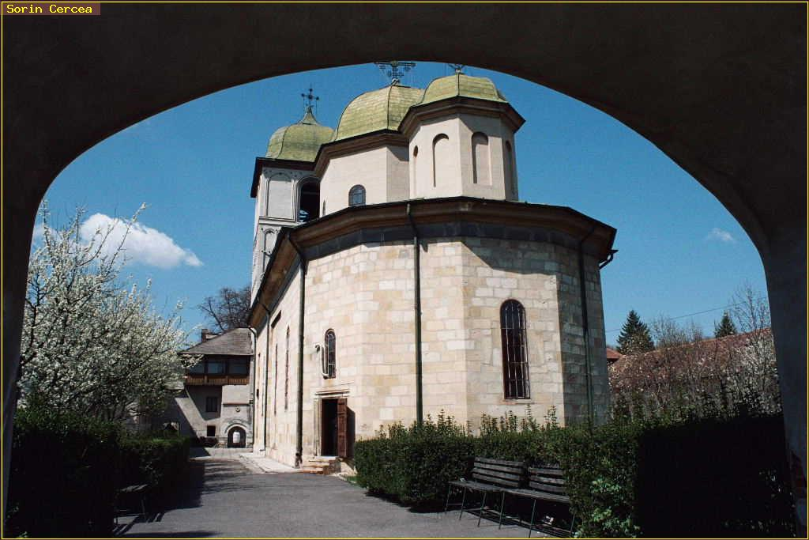

Slide 16
MULTILATERAL COMENIUS PROJECT 2013-2015
This project has been funded with support from the European Commission.
This publication reflects the views only of the author, and the Commission cannot be held responsible for any use which may be made of the information contained therein.

