Slide 1
FOLLOWING IN
THE FOOTSTEPS OF OUR ANCESTORS - THE STORYTELLERS

Slide 2
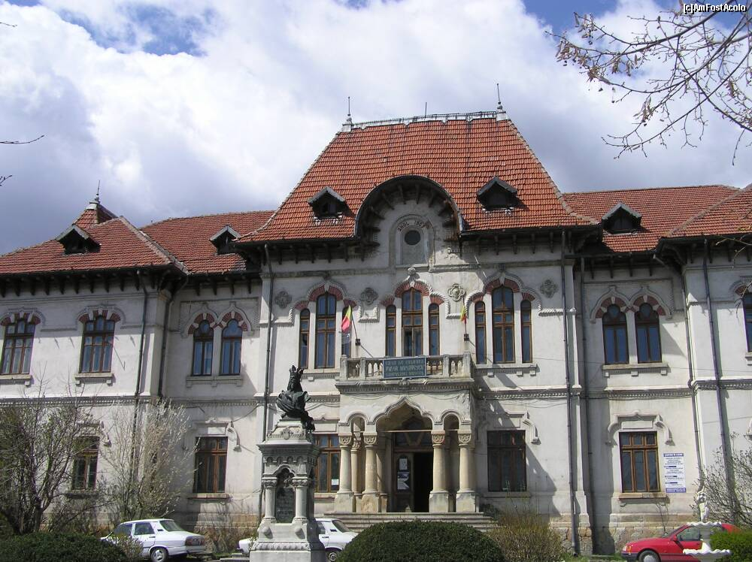
The City Hall
At the beginning of the twentieth century, Câmpulung Hall building was located in the beautiful Romanian classic style building from 1907 ("The Communal Ospel").

Slide 3
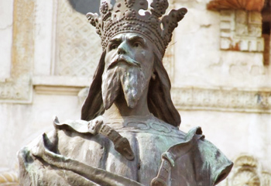
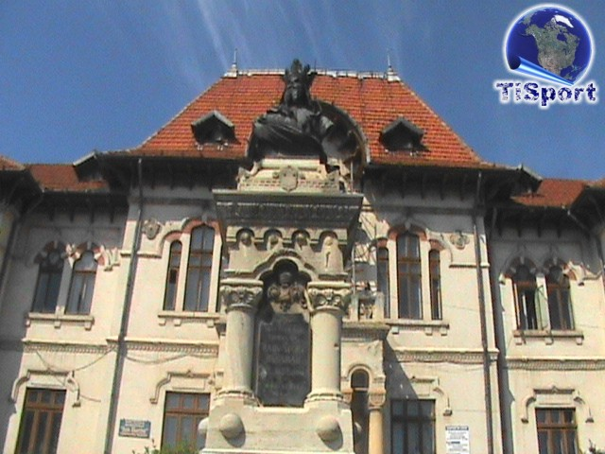
In front of the building was placed in 1910 a bronze statue dedicated to Negru-Vodă by the sculptor Dimitrie Mirea, statue that had initially been at the north end of „Pardon” Boulevard.

Slide 4
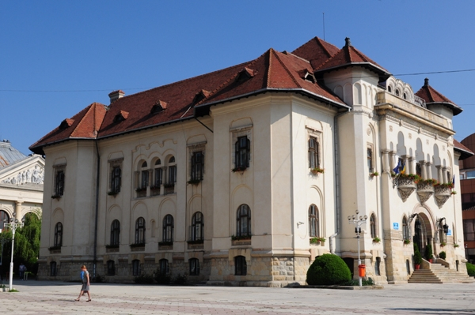
The current building of the City Hall was originally built as the seat of the Muscel Prefecture, while Câmpulung was, in times of the Kingdom of Romania up to the administrative reform of 1950, the residency of this county.

Slide 5
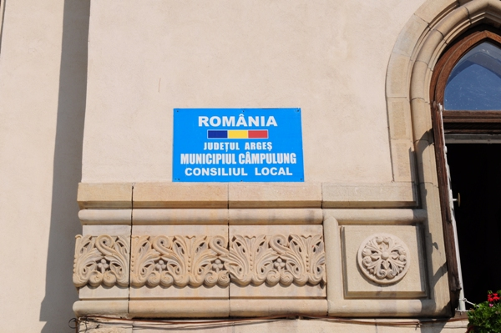
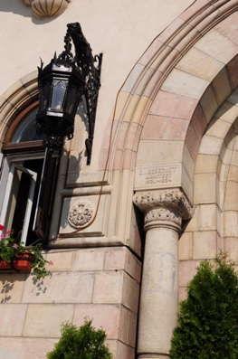
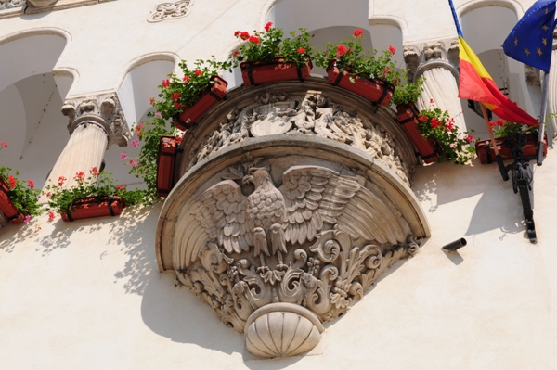
The City Hall imposes on the urban architectural landscape of Câmpulung by an overwhelming shape, coordinating with other buildings of the same period.

Slide 6
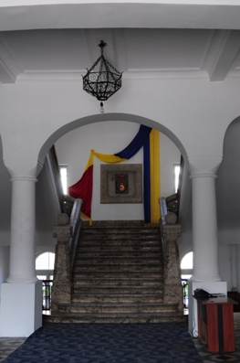
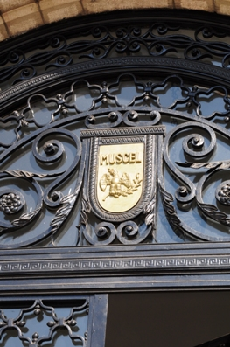
A monumental work in typical local style, it was built in 1934 by architect Dumitru Ionescu - Berechet.

Slide 7
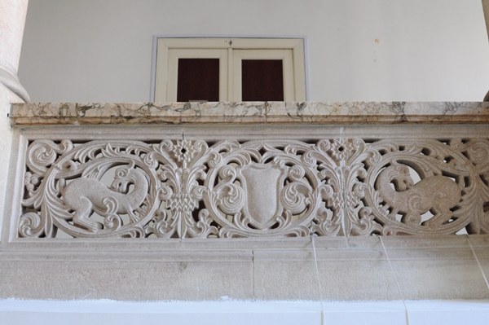
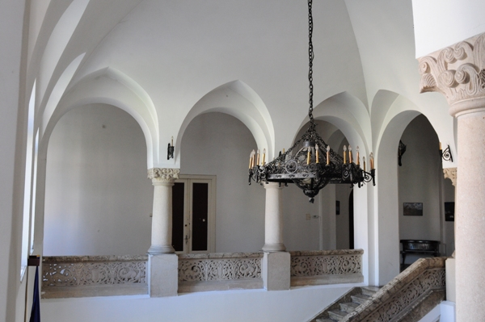
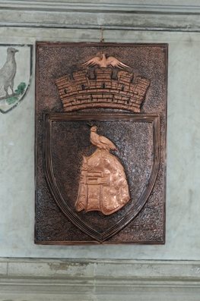

Slide 9
MULTILATERAL COMENIUS PROJECT 2013-2015
This project has been funded with support from the European Commission.
This publication reflects the views only of the author, and the Commission cannot be held responsible for any use which may be made of the information contained therein.

