Slide 1
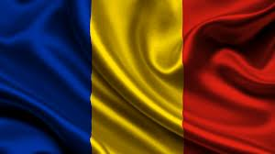
FOLLOWING IN
THE FOOTSTEPS OF OUR ANCESTORS - THE STORYTELLERS

Slide 2
The Art and History Museum
In Câmpulung and surroundings, history overwhelms you through the multitude of archaeological sites and historical monuments, a feeling that probably Grigore Tocilescu, director of the National Museum of Archaeology also had during the visit he made ​​here in 1889.
He recommended and supported the idea of ​​creating a museum in Câmpulung to save and preserve the testimonies of the past.

Slide 3
This resulted in the decision of establishing a museum publication in the Official Gazette No 116 of 26 August/ 7September 1889.
The core of the museum, housed at the beginning in the Negru-Vodă monastery, was administered directly by the Mayor, the abbot of the monastery and the headmaster of Boys School no. 1 in town.

Slide 4
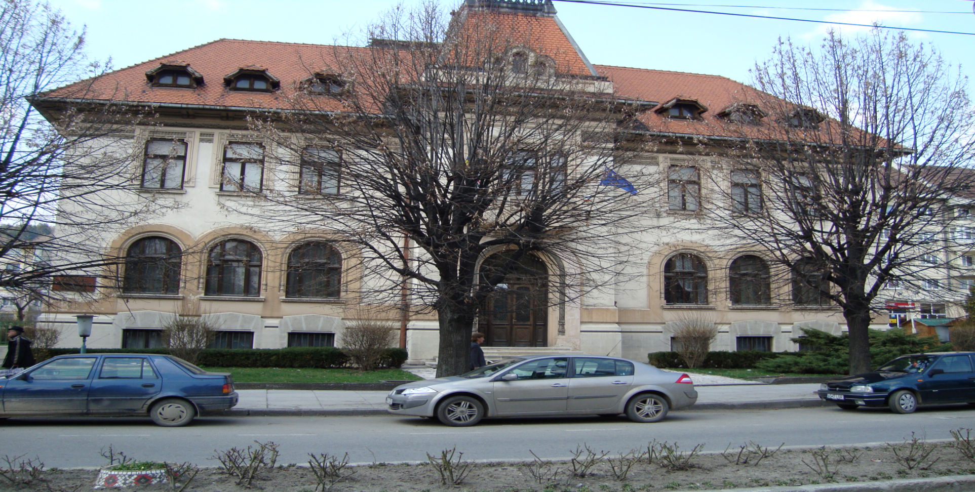
Over time, field archaeological research, purchases and donations have increased the museum collections, which were structured in 1952 into the current sections: history, art, science and ethnography.

Slide 5
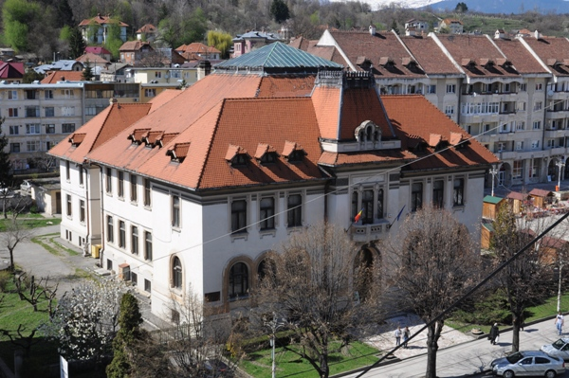
The museum’s building in the centre was erected between 1934-1936, after the layouts of architect Statie Ciotan.
The Museum of History and Art presents the history of Muscel area and its links with the surrounding counties, mediating a passage through a corridor of time, from prehistory until modern times.

Slide 6
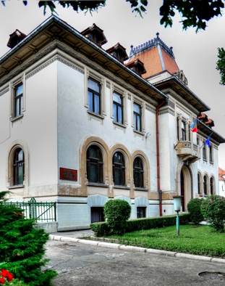
The museum team conducted archaeological research in almost all relevant locations in the city, discovering a variety of artifacts, objects of stone, bone tools (years 6000-1800 BC), from the cysts from the Bronze Age to the Hellenistic imported pottery, weapons from the archaeological excavations at camp Jidava, Roman ceramics with Dacian elements dating from the fourth century AD, Roman coins, all exposed now in the history department.

Slide 7
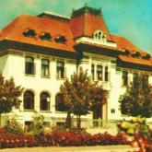
Museum exhibits include authentic discoveries from the Dacian settlement of Cetăţeni Muscel, the Muscel county flag from the nineteenth century, objects that belonged to local personalities of great importance in the Romanian culture and science.
The facsimile of the letter in Romanian Neacşu Lupu is not missing either.

Slide 8
The Department of Art includes a collection of valuable works by Romanian artists of the interwar period and after the Second World War, including paintings, sculptures and drawings signed by Theodor Pallady, Corneliu Baba, Henri Catargi, Constantin Baraschi, Oscar Han, Andrei Jiquidi, Nicolae Grant.
The museum also operates a collection of science, visited mainly by students.

Slide 9
MULTILATERAL COMENIUS PROJECT 2013-2015
This project has been funded with support from the European Commission.
This publication reflects the views only of the author, and the Commission cannot be held responsible for any use which may be made of the information contained therein.

